Slide 1
Network Analysis
Tomas Karpati MD tc.datascience@gmail.com
054-2002430

Slide 2

Network Analysis

Slide 3
Network Analysis
Network Theory: Based on Graph Theory

Slide 4
Network Analysis
Network Theory
Vertex or Nodes
Entities: objects, places, Individuals, etc
Have fixed properties

Slide 5
Network Analysis
Network Theory
Edges:
Represent the relationships, links or ties between nodes
Tangible edges (roads, computer networks)
Intangible edges (friendship, family relationship)

Slide 6
Network Analysis
Network Theory
Networks can be classified as:
Undirected
Directed
Unidirectional
Bidirectional

Slide 7
Network Analysis
Network Theory
Weighted graph
Weighted nodes
Weighted edges

Slide 8
Network Analysis
Network Theory
Number of Nodes: |V|
Number of Edges: |E|
Directed graph:
max|E| = |V|.|V-1|
Undirected graph:
max|E| = |V|.|V-1|/2
Dense graph:
High number of edges
Sparse graph:
Only few edges

Slide 9
Network Analysis
Network Theory
Path: sequence of nodes connected by edges
Walk: like a path but passing more than once over the same edge may be possible.
Trail: a walk where nodes can’t be repeated
Dense graph:
High number of edges
Sparse graph:
Only few edges

Slide 10
Network Analysis
Metrics:
Centrality: # of direct connections for a node or group
Hub: a node with a number of links that greatly exceeds the average
Authority: nodes pointed by hubs

Slide 11
Network Analysis
Metrics:
Centrality: # of direct connections for a node or group
Group Cohesion: easy of connection (average distance)

Slide 12
Network Analysis
Metrics:
Centrality: # of direct connections for a node or group
Group Cohesion: easy of connection (average distance)
Group Density: robustness of the network (% of connections among all possible connections)

Slide 13
Network Analysis
Metrics:
Centrality: # of direct connections for a node or group
Group Cohesion: easy of connection (average distance)
Group Density: robustness of the network (% of connections among all possible connections)
Betweenness: shortest path between two nodes or groups

Slide 14
Network Analysis
Network Theory
Cohesive subgroups: Well connected group of nodes
Community: a subset of nodes within the graph such that connections between the nodes are denser than connections with the rest of the network (joined by high betweenes nodes)
Clusters: group of nodes more connected to each other than to other nodes (determined using cluster analysis)
Cliques: group of nodes fully connected to each other (adjacent nodes)

Slide 15
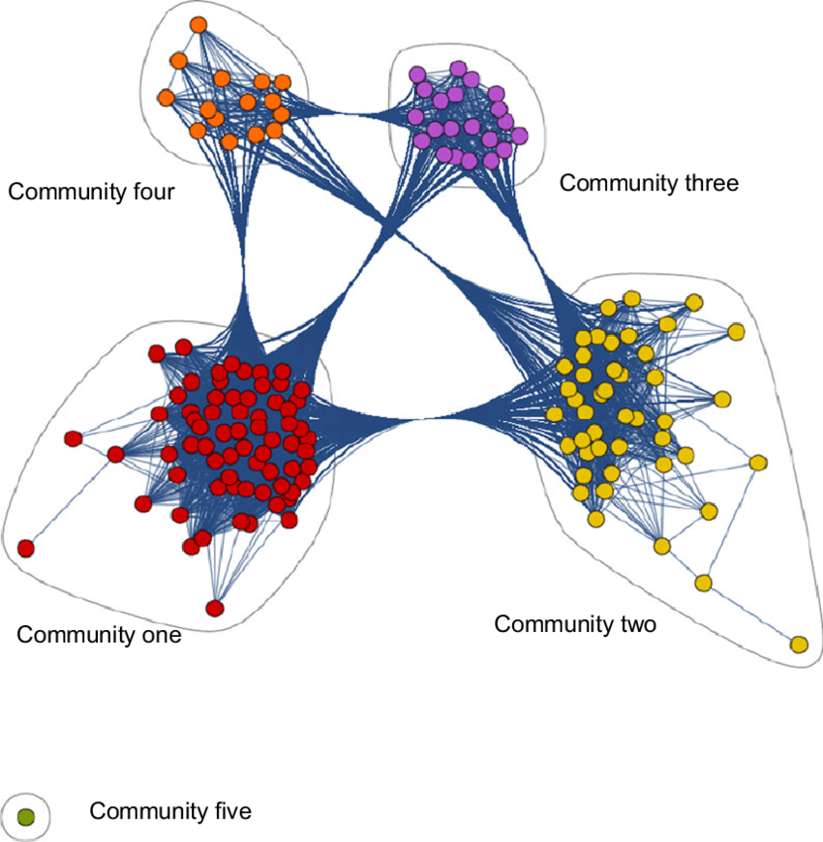
Network Analysis

Slide 16
Network Analysis
Usages
Community detection
Feature enrichment by adding clusters
Time changes - clusters driving changes
Fraud analysis
Workflow optimization
Disease surveillance
Terrorist networks

Slide 17
Network Analysis
Examples of Network Analysis
Airlines/Airports connections - https://www.visualcapitalist.com/air-traffic-network-map/
GPS maps (from point A to B)
Web-pages connectivity
Bank transactions - https://arxiv.org/pdf/1908.02591.pdf
Hospital workflow
Healthcare resource abuse- https://www.aaai.org/ojs/index.php/aimagazine/article/view/2630/2554
Top influencers - https://twitter.com/ismailfahmi/status/1267390823693340673/photo/1
Bioinformatics - https://chengf-lab.github.io/COVID-19_Map/

Slide 18
Network Analysis
Derivative Fields of Network Analysis
Graph Databases
Neo4J - https://neo4j.com/sandbox/
Process mining
ProM6 (open source) - https://www.promtools.org/doku.php
Disco - https://fluxicon.com/disco/
Celonis - https://www.celonis.com/
Python - https://pm4py.fit.fraunhofer.de/
R - https://medium.com/@gscheithauer/process-mining-in-10-minutes-with-r-1ab28ed74e81

